Slide 1

Individual-based Modelling with NetLogo
Used to model the behaviour of agents
The simulation space is divided up into patches which represent the environment
The agents that move around are called turtles in NetLogo

Slide 2
Individual-based Modelling with NetLogo
Three tabs when you open the program
Interface tab where you see the program in action
Information tab where you can write details explaining the model
Procedures tab where you write the code

Slide 3
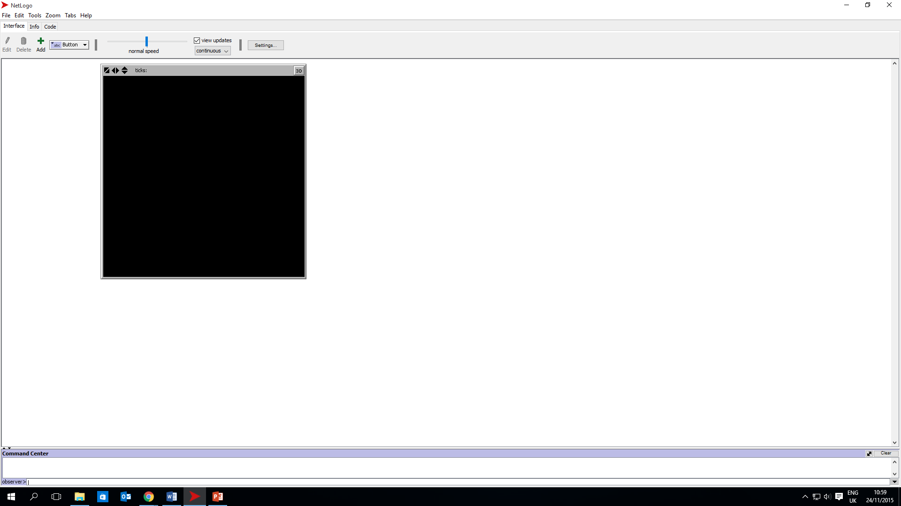
Individual-based Modelling with NetLogo

Slide 4
Individual-based Modelling with NetLogo
Coding in NetLogo
Create procedures that the agents obey
Use the keyword to,
followed by the name of the procedure,
and then the set of instructions that make up the procedure;
finally, indicate that there are no more instructions for this procedure by ending with the keyword end.
If statements
If energy = 0 [die]
Ifelse statements
ifelse any? turtles in-radius vision [set color red][set color blue]

Slide 5
Individual-based Modelling with NetLogo
Model Examples included with NetLogo
epiDEM Basic –Disease Spread Model
Bacteria Hunt Speeds – Natural Selection Model
Flocking - Group Behaviour
Robby the Robot - Genetic Algorithm

Slide 6
Individual-based Modelling with NetLogo
Resources
https://ccl.northwestern.edu/netlogo/ - download the model, read dictionary, access tutorials
http://modelingcommons.org/account/login - 100s of models available for download
http://www.complexityexplorer.org/ - series of courses many of which use NetLogo
http://stackoverflow.com/tags/netlogo/- ask questions with the tag ‘NetLogo’
http://rnetlogo.r-forge.r-project.org/ - RNetLogo, an R package that allows you to run NetLogo through R

